Slide 1
Do you know about the built-in bullet styles in template placeholders?
First level ‘normal’ text is formatted like this. It’s deliberately formatted with an ‘invisible bullet’.
DON’T use this text level if you want to use a bullet. Instead…
…With your cursor at the beginning of a text box line, simply press Tab to toggle to each level style:
  Second level is formatted pink and bold like this
    Third level is a pink bullet
      Fourth level is a pink star bullet
        And Fifth level a dash sub-bullet
Pressing Shift+Tab will toggle you backwards through these bullet styles
  Try it here!

Slide 2
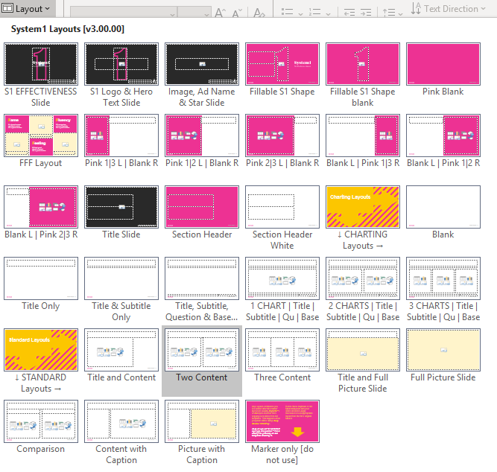
Use Layouts and Placeholders
  A gallery of Layouts exists to help you format and align content quickly and consistently
When you create a new slide, choose whichever Layout best suits your content
Once you’ve added and formatted content within placeholders, it’s much easier to rearrange items on slide by just changing the slide layout
  Try changing this slide to a ‘Three Content’ layout and see what happens…
  Learn to love your Layouts!

Slide 3

Simplify
Our Design Principles
Our identity is simple, bold and joyful.
Powerful stories come to the forefront.

